Slide 1


Savitribai Phule Pune University
Department Of Technology
B.S.C. Data Science
CoviSense
(Predicting future trends of Covid-19 )
Guided By : prof. Siddhesh Mhatre

Slide 2


CoviSense: Predicting Future COVID-19 Trends
CoviSense is an advanced prediction model designed to forecast future COVID-19 outbreaks and trends. This project aims to support public health authorities by providing actionable insights to anticipate changes in virus spread, enabling better preparation and response. By leveraging extensive data and sophisticated algorithms, CoviSense aspires to be a vital tool in managing ongoing and future pandemic challenges more effectively.

Slide 3
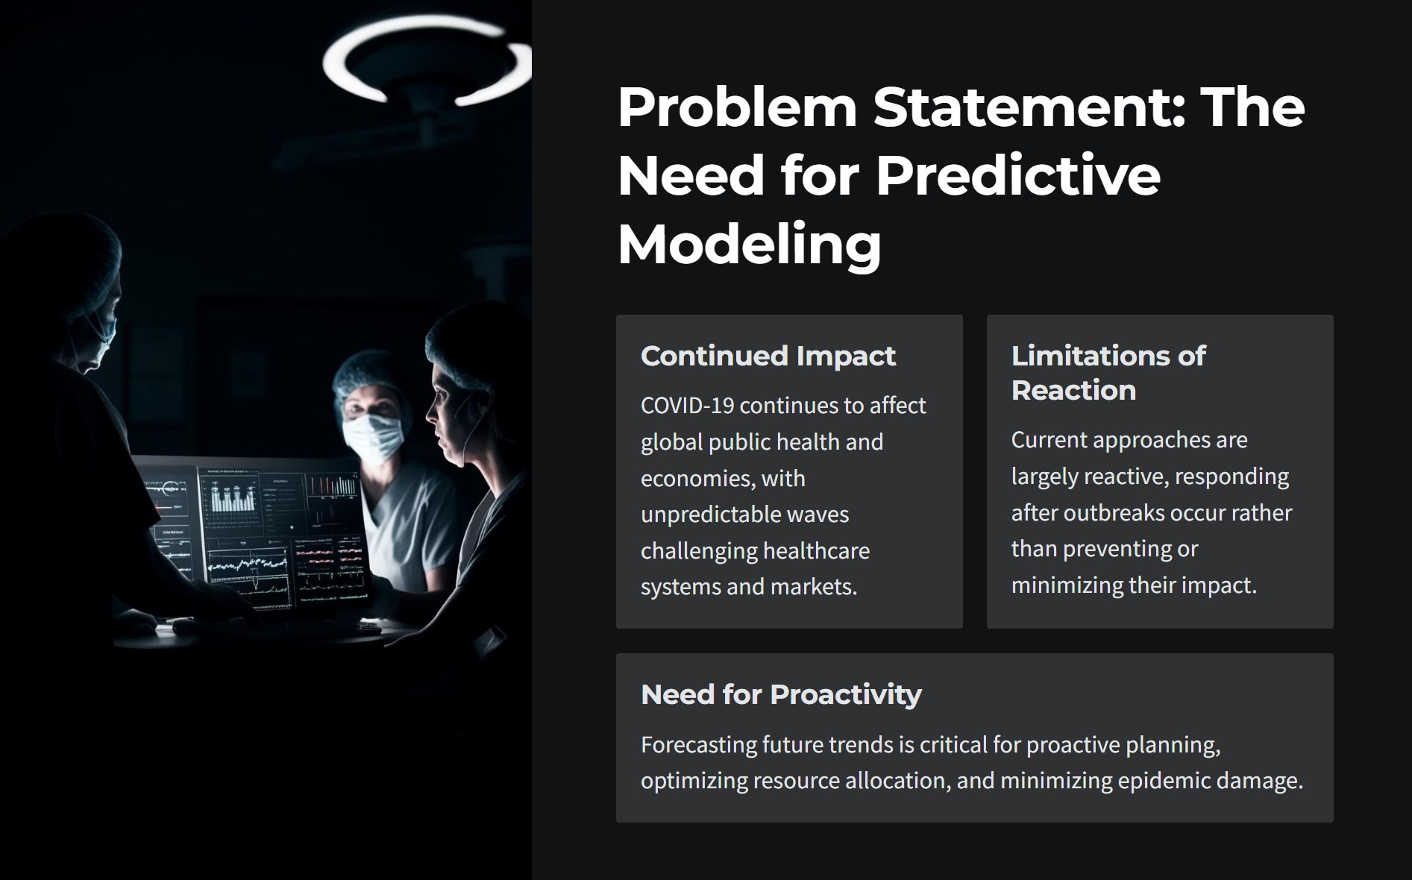

Slide 4
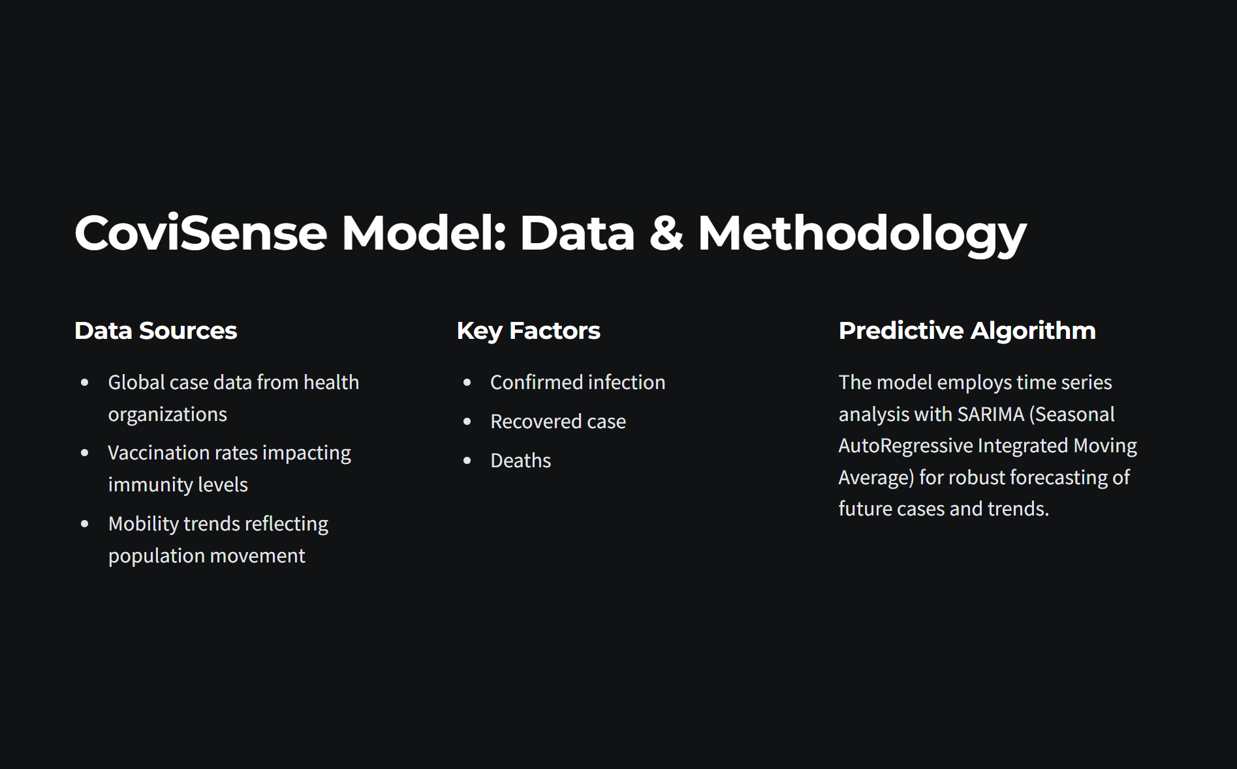

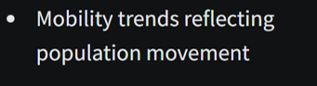

Slide 5
Tech Stack
Dataset : Google Open Covid -19 (All region confirmed cases)
Dataset Shape: (140364,6)
(132324,6)
Model : SarimaMAX
For Web Integration : Flask

Slide 6
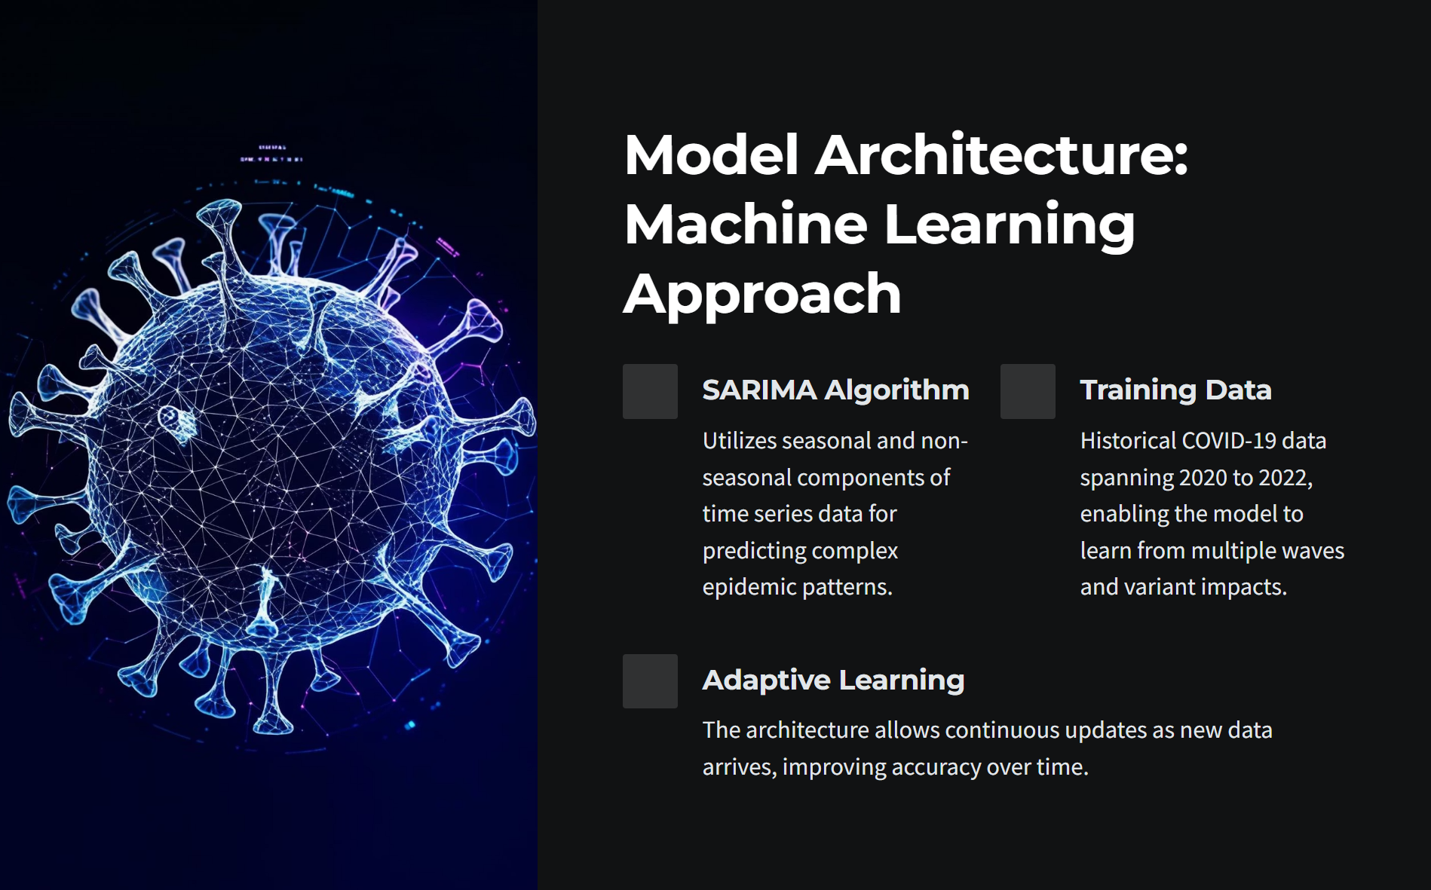

Slide 7
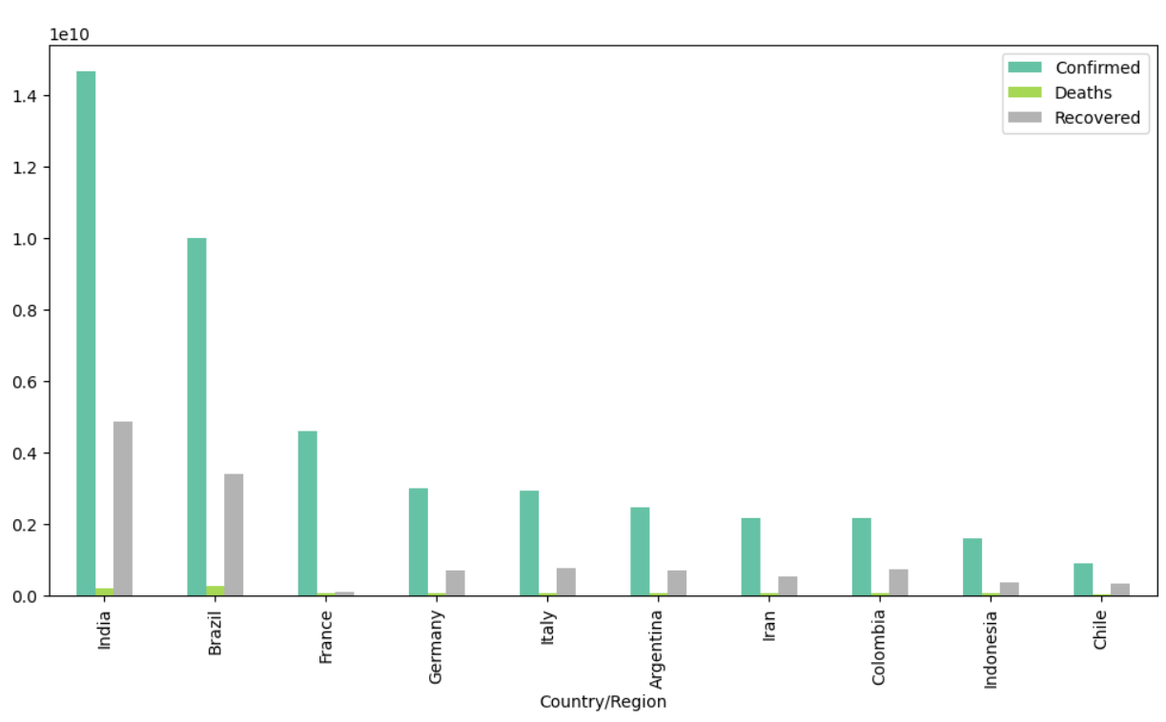

Slide 8
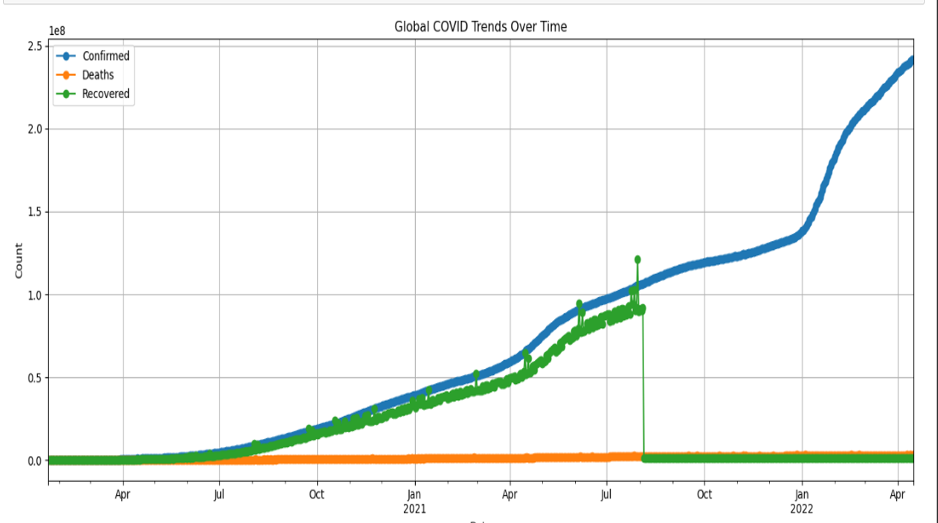

Slide 9
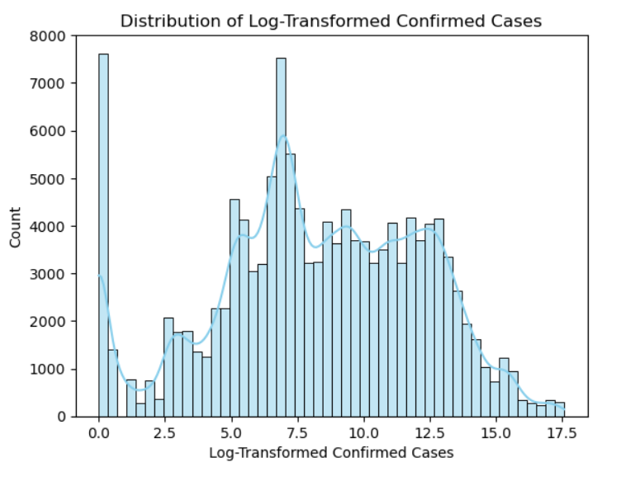

Slide 10
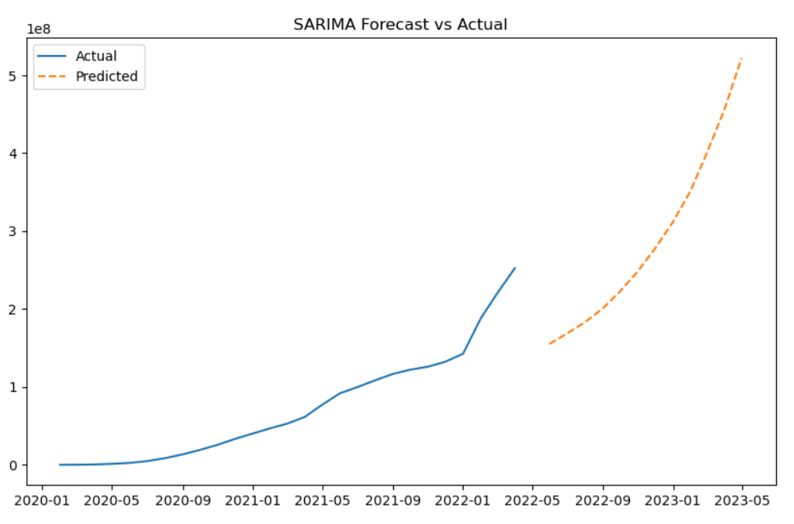

Slide 11
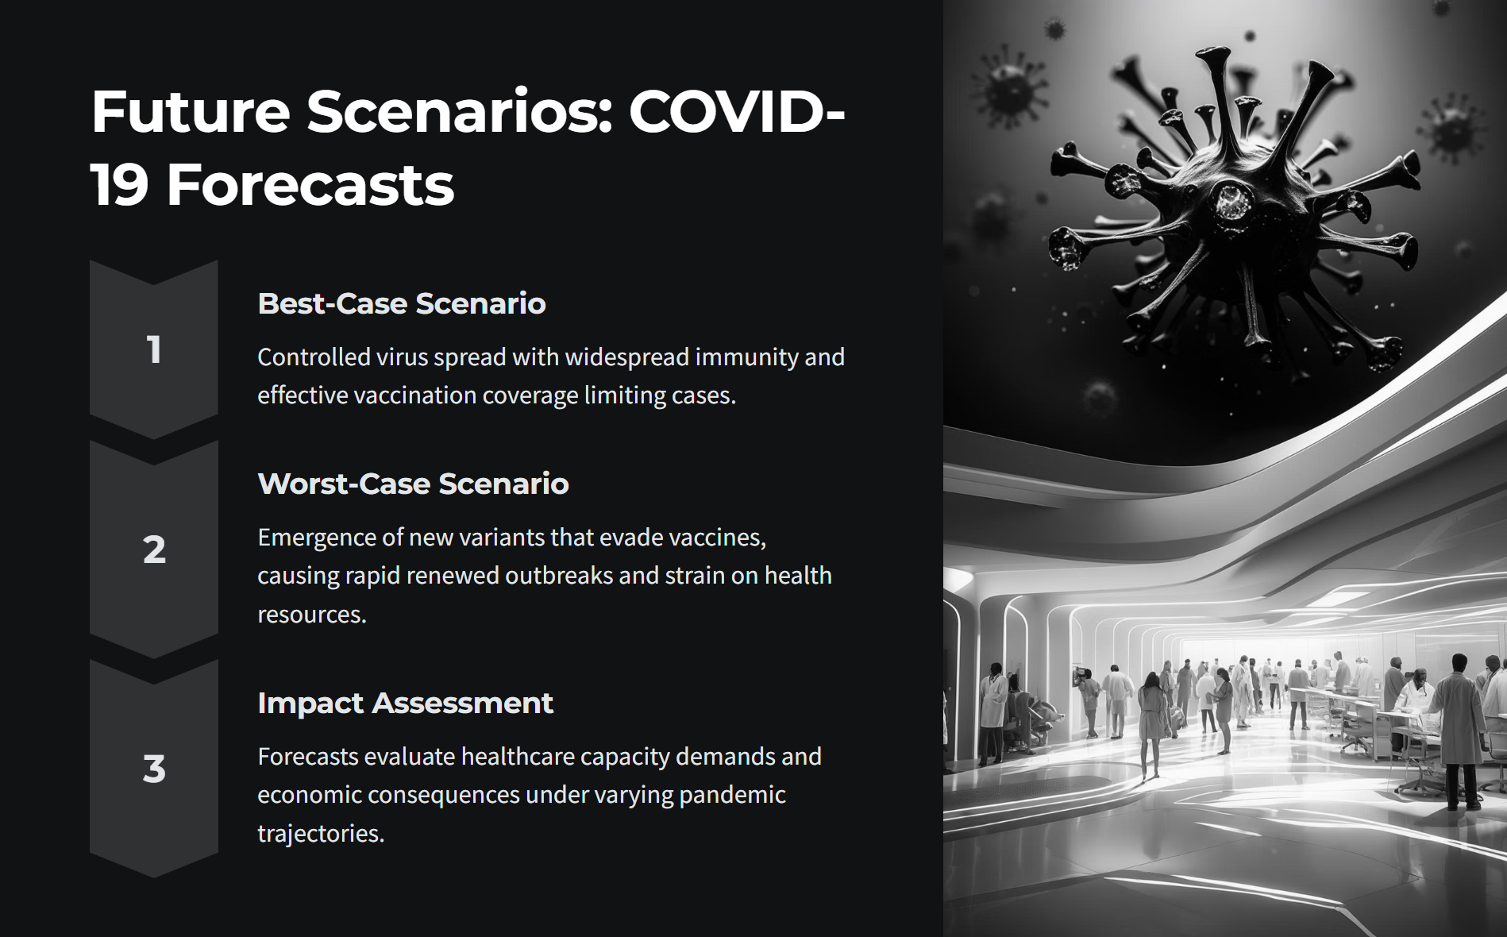

Slide 12
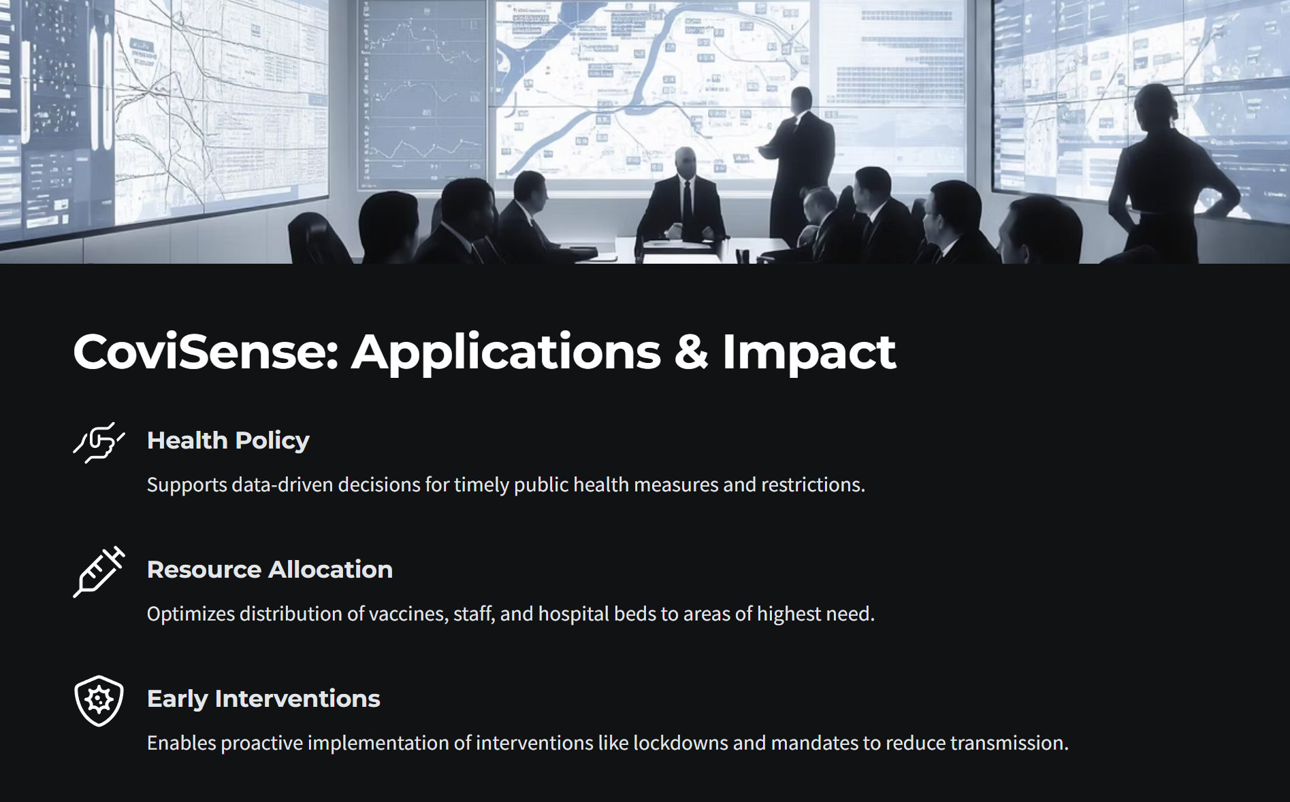

Slide 13
